Slide 1
Unblock’d
Ben Lafene, Sam Jansen, Spencer Snider
Advisor: Prof. John Gallagher

Slide 2
Goals
After conducting market research into existing habit tracking apps, we found that many of the apps on offer today are bogged down by paywalls in front of core functionality, outdated user experience, or a lack of meaningful motivation for users
To create a habit tracking app that will be easy and rewarding to build into a user's daily life:
First, we aim to create a fluid user experience which is simple, intuitive, and avoids frustration.
We also aim to provide social features to all users, utilizing accountability as a primary method of motivation.
Our final big feature is the implementation of a virtual pet. This pet would encourage you to complete your tasks/goals, and provides a medium for you to interact with your friends.
In summary, we hope to create a new habit tracking experience which will integrate seamlessly into users lives.

Slide 3
Intellectual Merits
Social Features
Though some of habit tracking applications on the market today have a degree of socialization, we aim to make this a primary motivator behind user activity and we plan to offer this functionality at no cost to all users.
We will do this by implementing groups for users to join which will be oriented around specific activities. Users will be able to see who in the group is achieving well and who could use extra encouragement.
Virtual Pet
We have observed in our lifetime the power of other virtual pet software such as Pokemon and Tamagotchi to be a daily part of someone’s life.
We aim to use the human attraction to cute things as well as the sub-cost fallacy in order to incentivize users to stay committed to their goals.

Slide 4
Broader Impacts
In making an app which encourages consistency without discouraging the user, we hope to change the human outlook on living a well balanced life through maintaining good habits.
While there is motivation in our society now to maintain habits, much of this comes from negative reinforcement. People go to the gym or open a book not because they want to but because they are afraid of the negative implications of not doing so. We hope that by presenting maintaining positive habits in a more friendly manner, we will reframe the process of building them as something that is enjoyable and meaningful to do.
We also hope to change the group dynamics around habits. Much of that dynamic now is focused on victory or domination, but our implementation of groups will make the experience much more cooperative and focused on positive encouragement from friends and family.

Slide 5
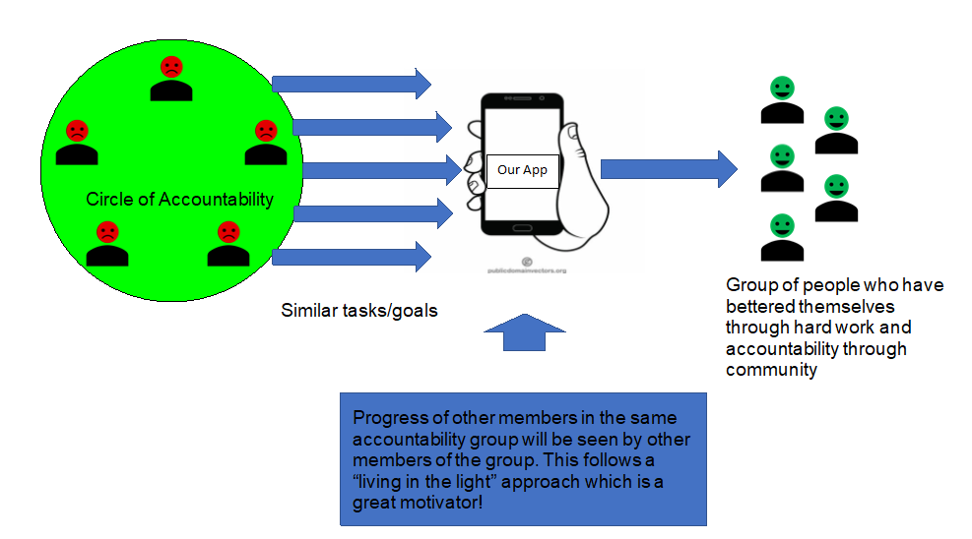
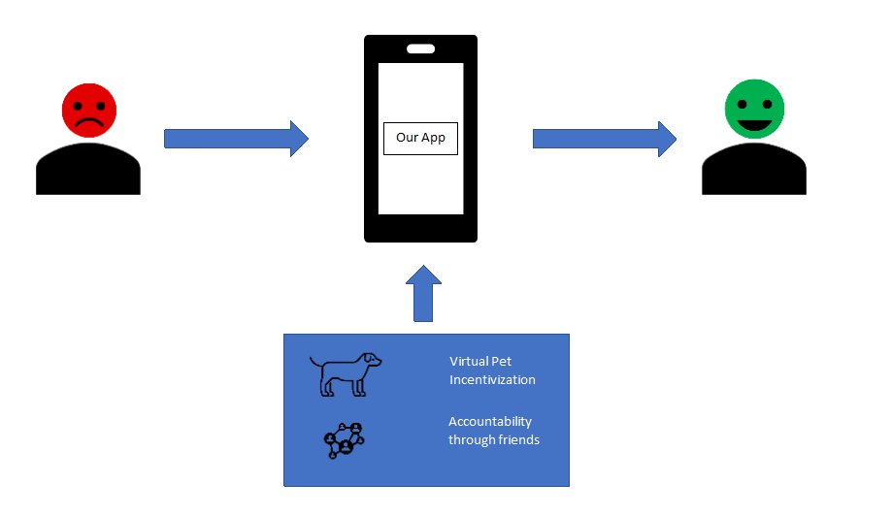
Design Specifications
Our application includes both social features which allow users to share tasks and task completion as well as a virtual pet feature to act as an outside source of motivation for each individual user
The social features are implemented as networking features which allow users to share data and the virtual pet takes the form of a specific widget which will be present on the main screen where users view their tasks. The idea is that these two different streams of information provide the user with the feeling that the completion of their tasks matters to someone or something other than themselves.

Slide 6




Technologies
We utilized a suite of different technologies in order to achieve our goals.
Our programming was completed in a framework called Flutter. Flutter leverages the dart programming language, and its main selling point is the ability to develop an Android and iOS application simultaneously. Flutter builds mobile applications as a series of widgets which are capable of immense amounts of layering, communication, and reactivity.
In order to ensure that we were truly creating a multiplatform application, we used two different development environments (windows and mac) as well as their corresponding mobile emulators (Android and iOS) in order to both develop and test our application.
For storage, we relied on Firebase Firestore’s NoSQL database in order to store everything from user data and logins to pet cosmetics.

Slide 7
Milestones
January 10 - Began development of application, met to share knowledge gained on flutter framework
January 24 - Created initial placeholders for task and pet creation, home page
February 14 - Second iteration of task creation form completed, pet carousel completed
February 28 - Firebase database set up, pet naming and customization placeholders implemented, home page first iteration completed
March 14 - Task creation form finalized, pet creation screen finalized, firebase database updated with actual user data, login completed
March 21 - Pet customization screen finalized, tasks marked as completed on homescreen, pet implemented on home screen

Slide 8
Challenges
Working in and learning the flutter framework, this was difficult because it uses a nested widget structure for all of its code. Introduced many challenges with making screens reactive and updating shared classes
Finding a database technology which worked for us. Spencer spent some time investigating MongoDB only to learn that it was not going to work for our project. Had to jump ship over to Firebase
Finding art assets and placeholders for the pet creation functionality
Flutter update during development which wreaked some havoc on our source control
iOS emulator took some time to get up and running

Slide 9
Results
Accomplishments so far:
Implementation of all core functionality
Registering as a user
Logging in
Creating a task
Viewing that task on the home page
Marking the task as complete
Pet customization screen prototyped
Notification infrastructure
Database setup, pushing users and pets to db

